Slide 1
Confederate Monuments
Photo Set
Historic and Contemporary Images

Slide 2
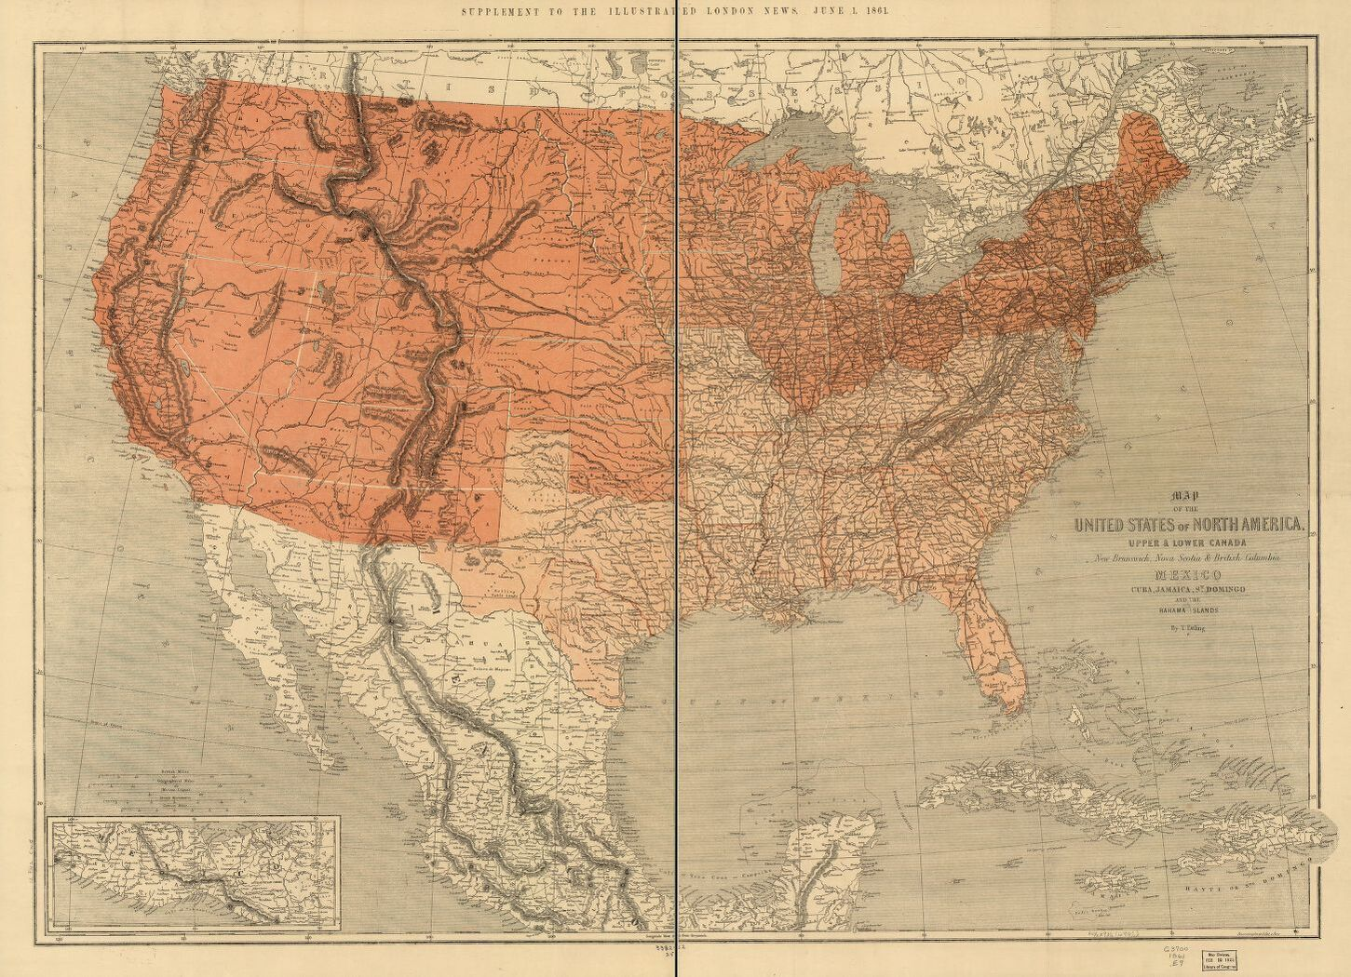
Notes:
Map of the United States. 1861

Slide 3
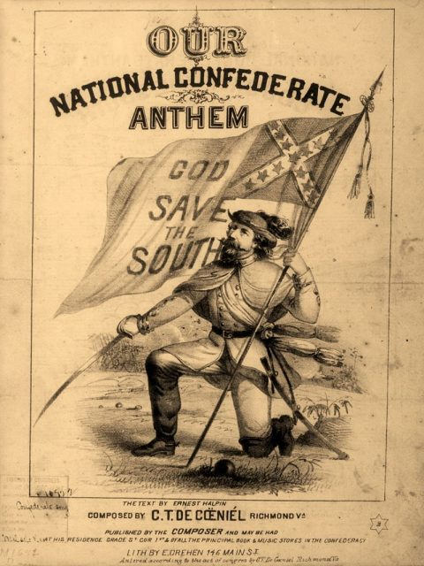
Notes:
Map of the United States. 1861

Slide 4
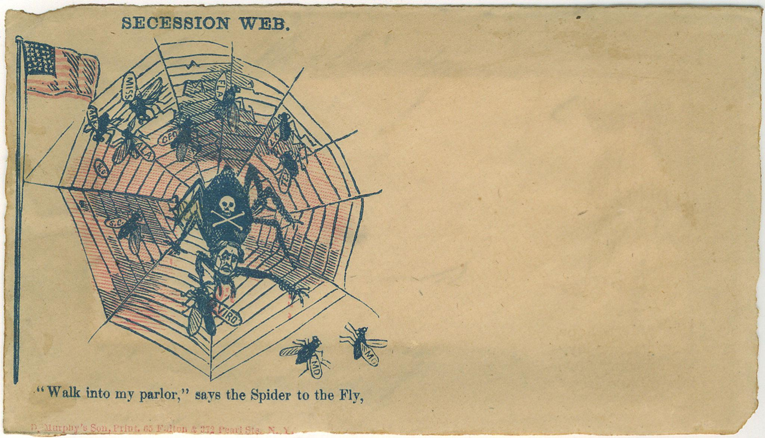
Notes:
Map of the United States. 1861

Slide 5
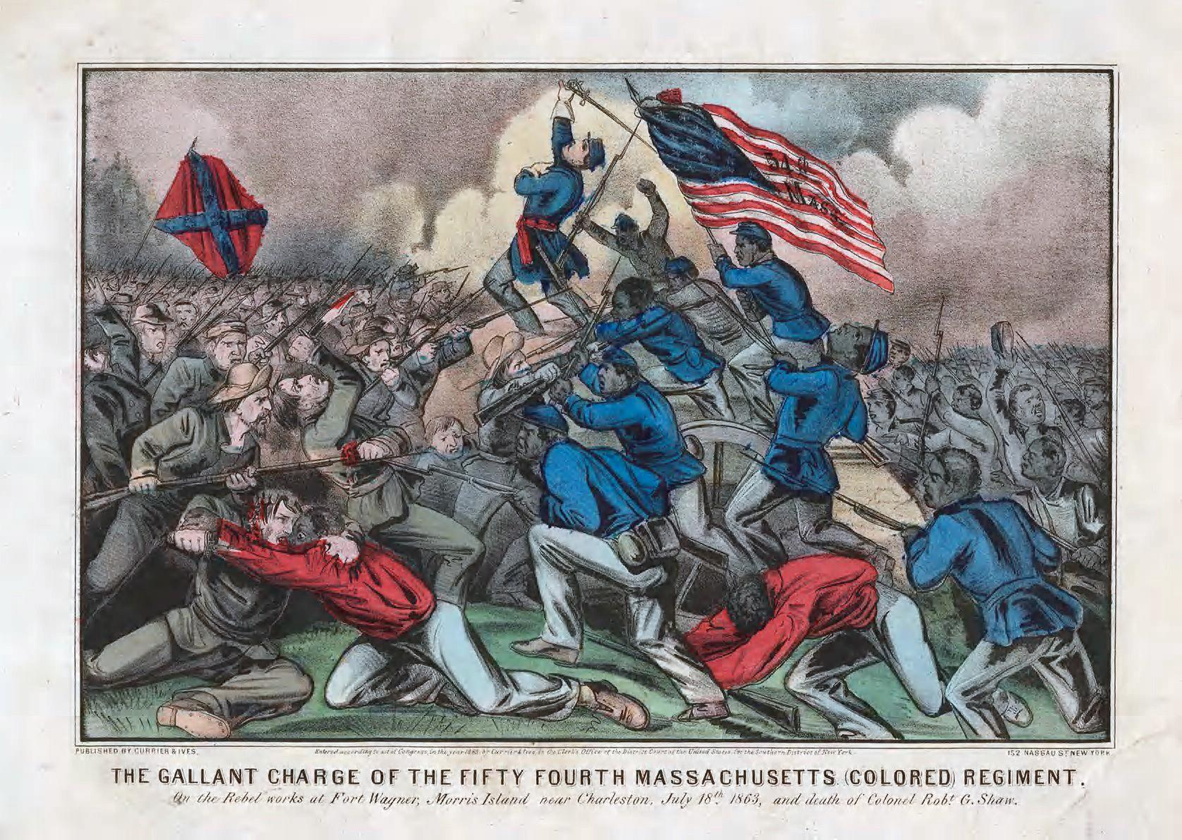
Notes:
Map of the United States. 1861

Slide 6
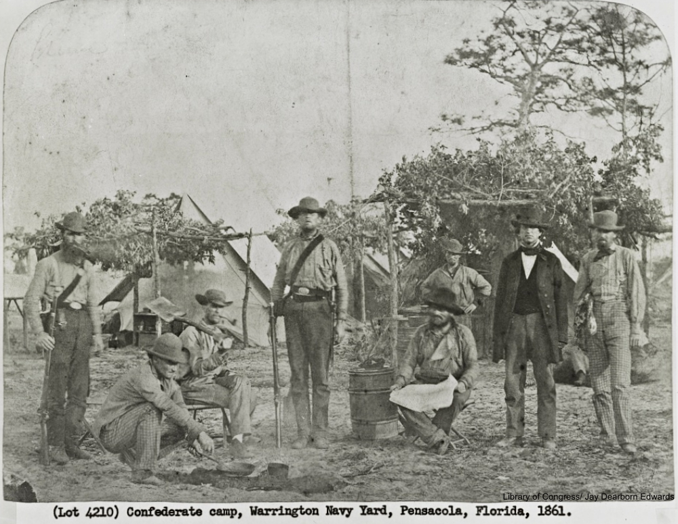
Notes:
Map of the United States. 1861

Slide 7
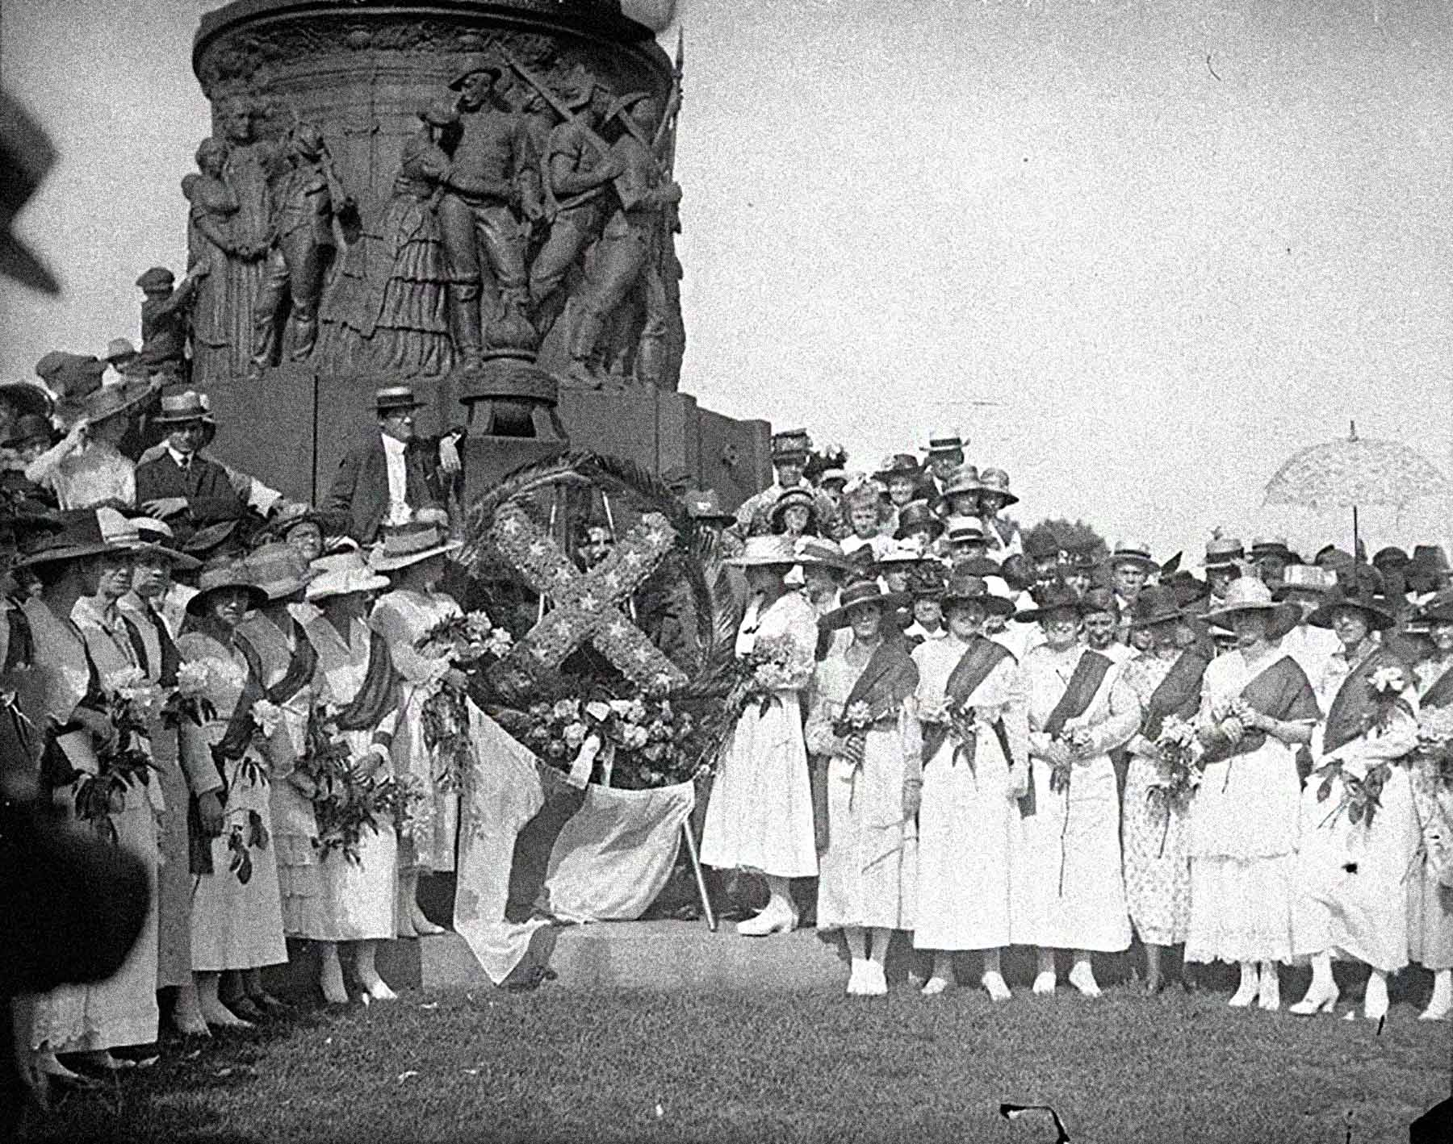
Notes:
Map of the United States. 1861

Slide 8
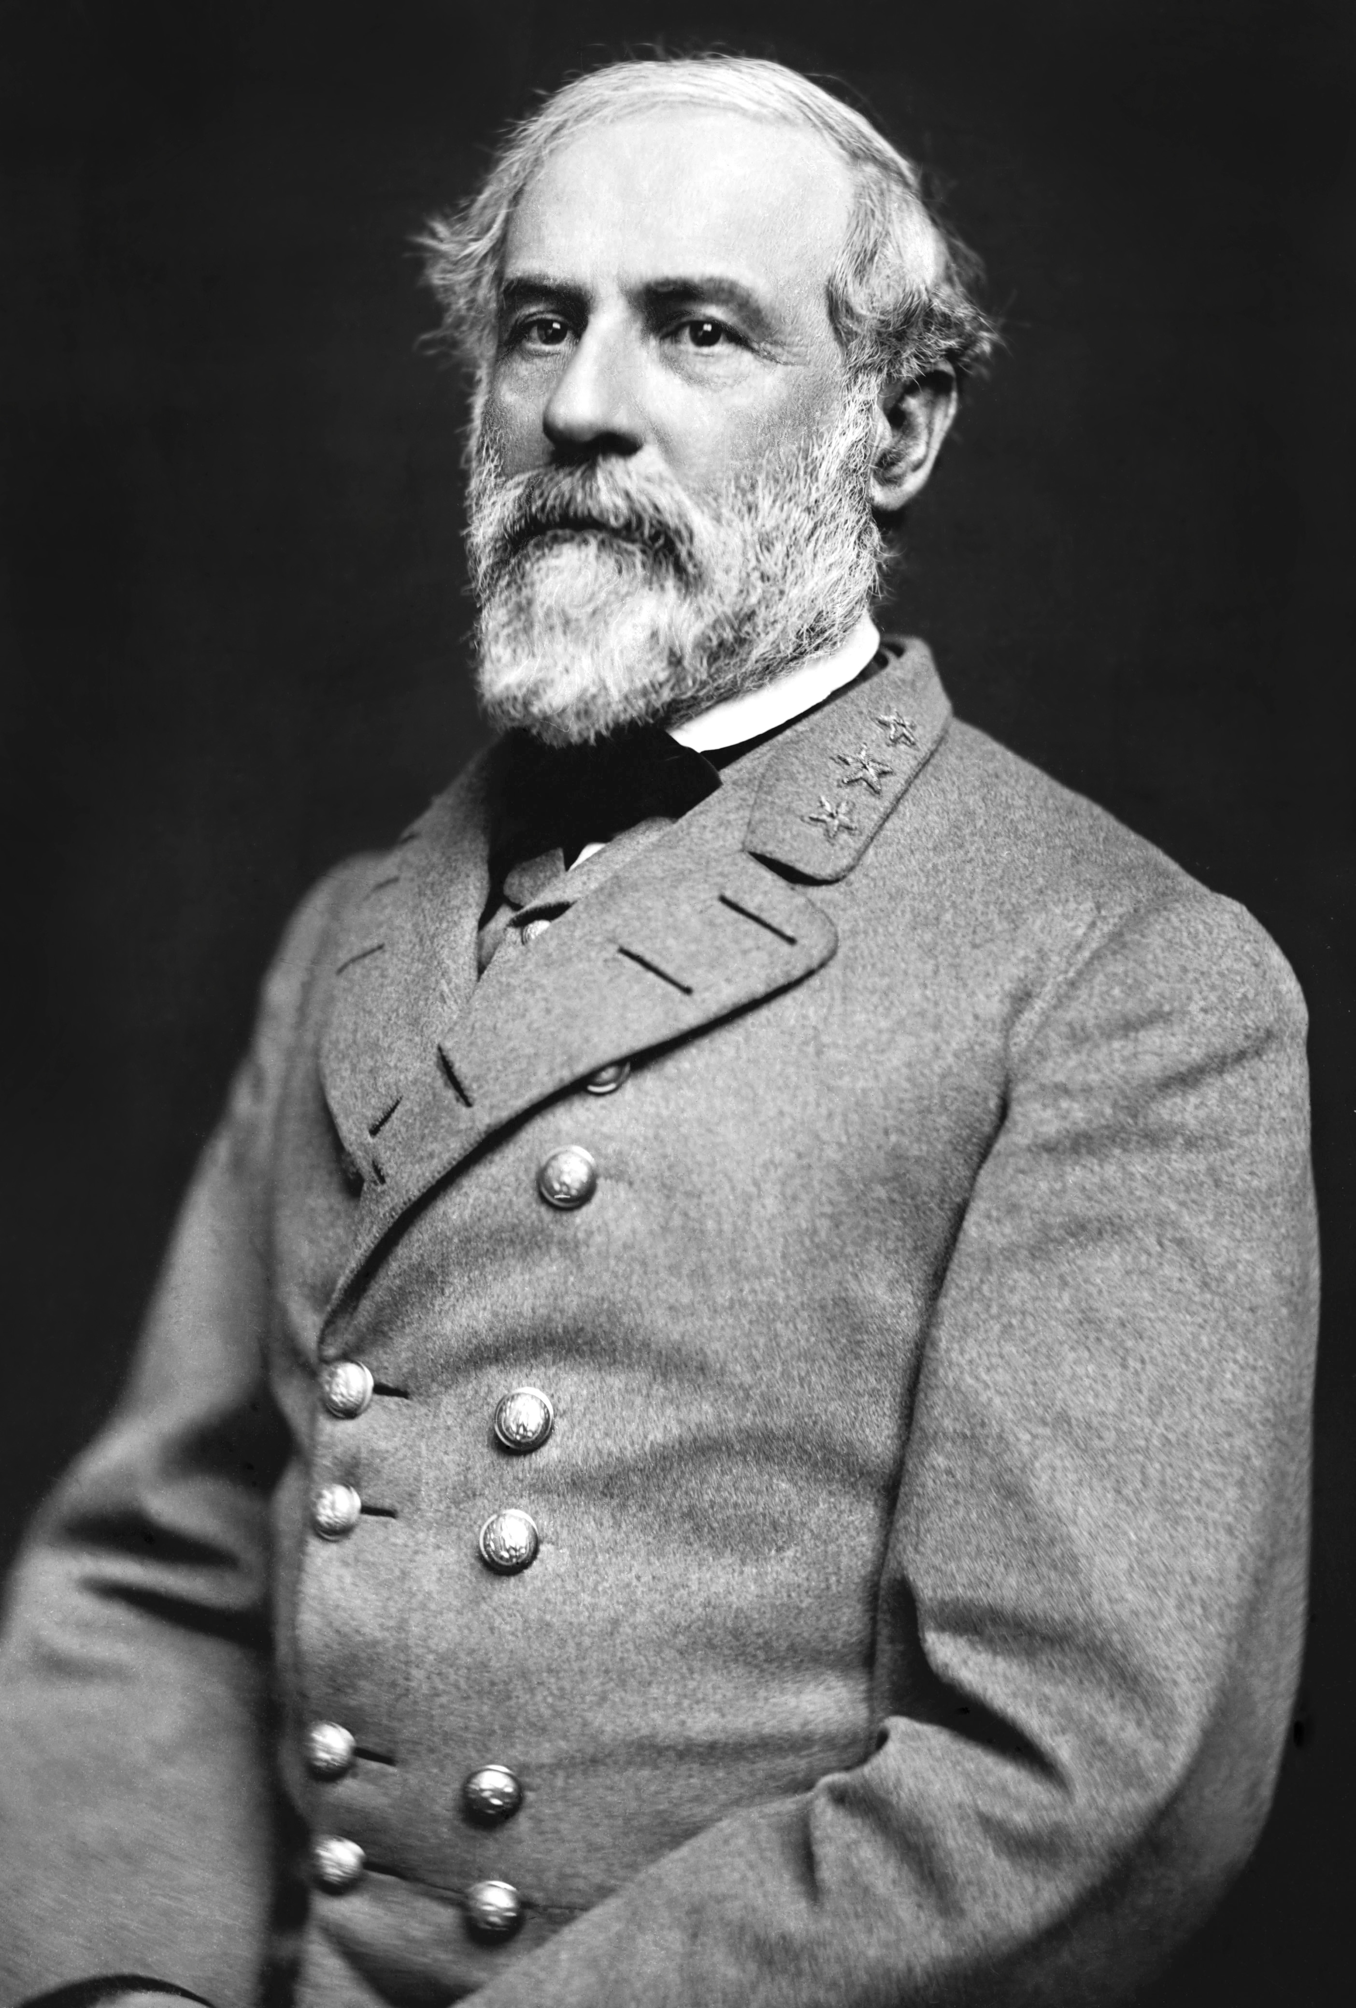
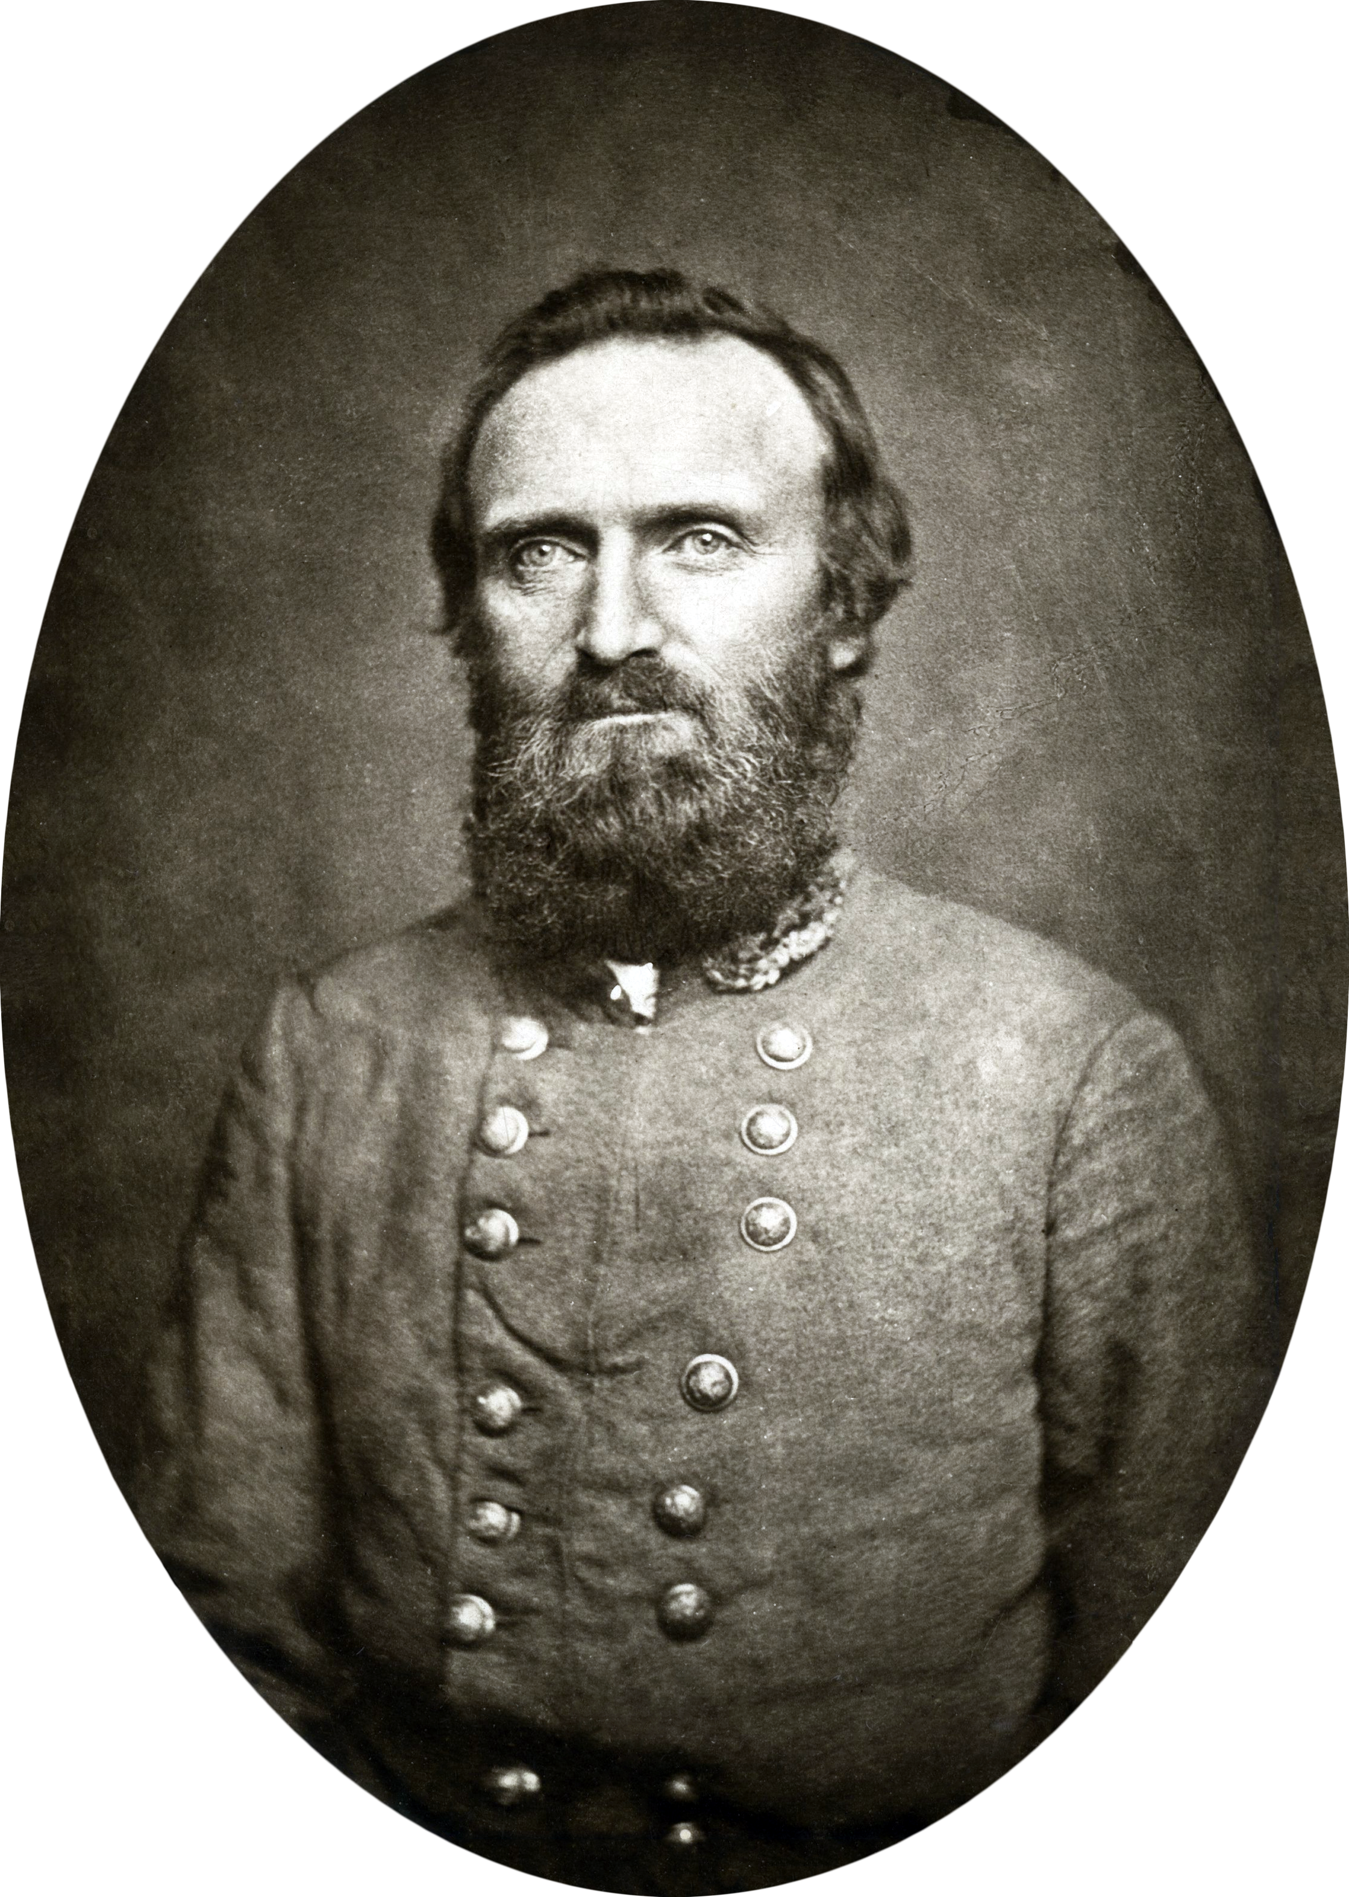
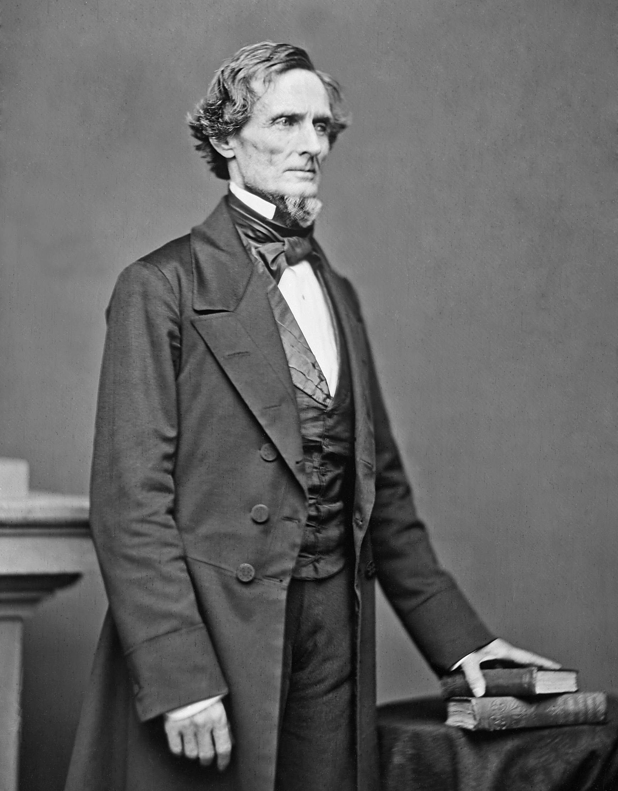
Notes:
Map of the United States. 1861

Slide 9
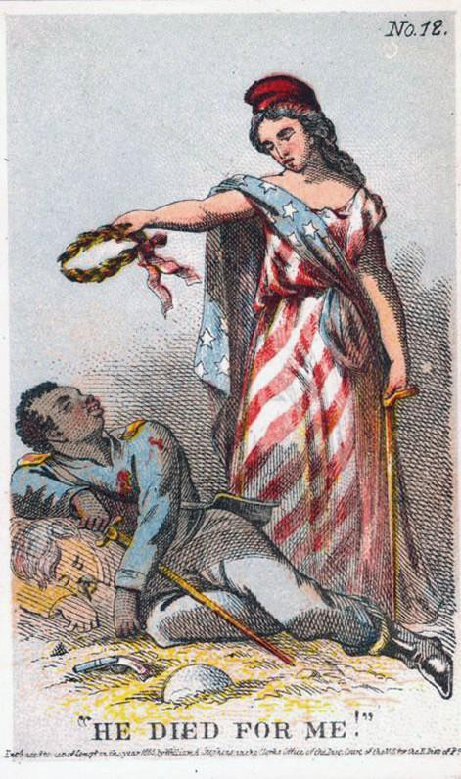
Notes:
Map of the United States. 1861

Slide 10
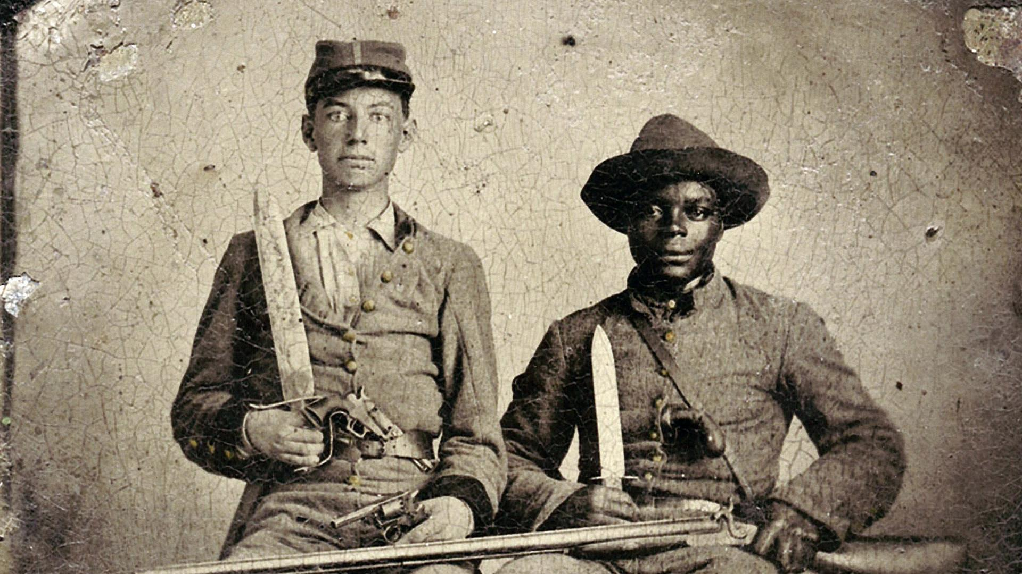
Notes:
Map of the United States. 1861

Slide 11
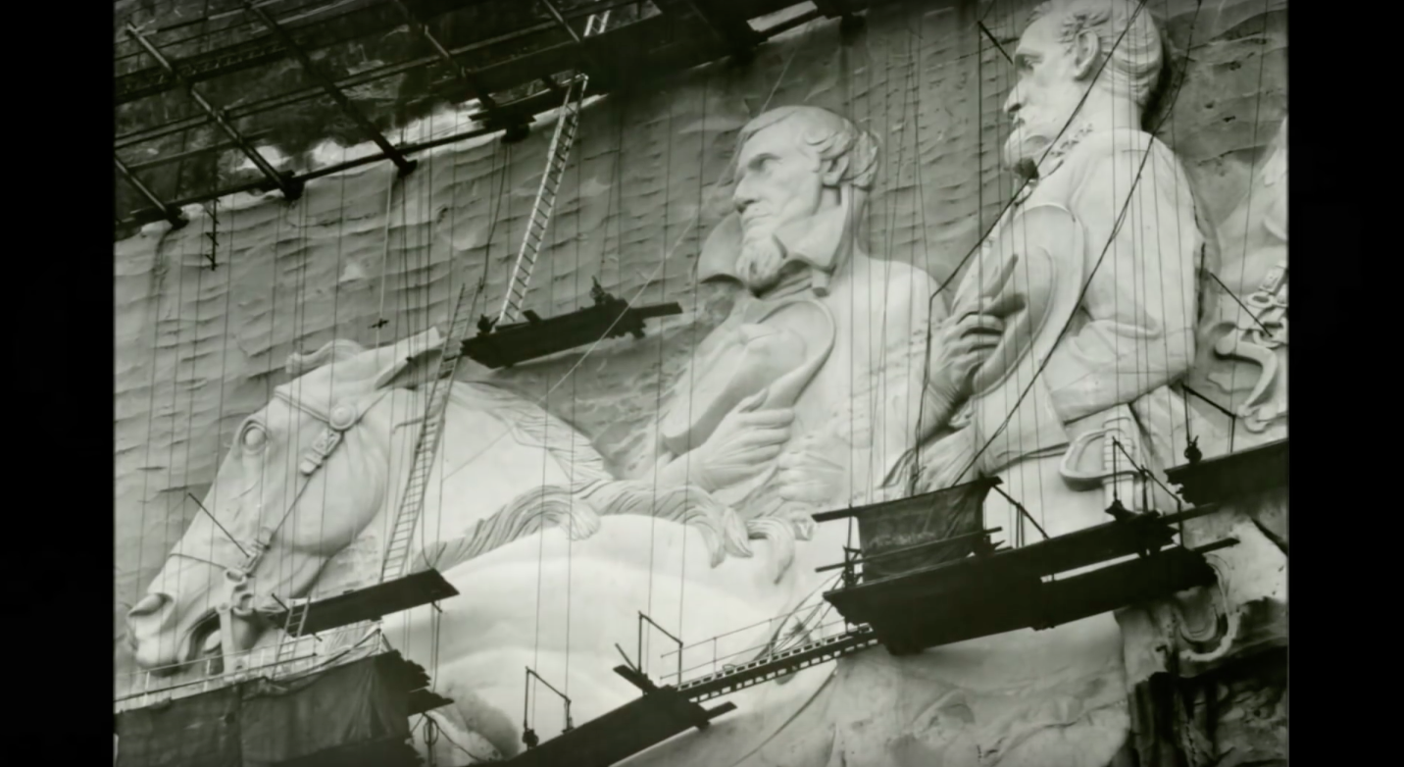
Notes:
Map of the United States. 1861

Slide 12
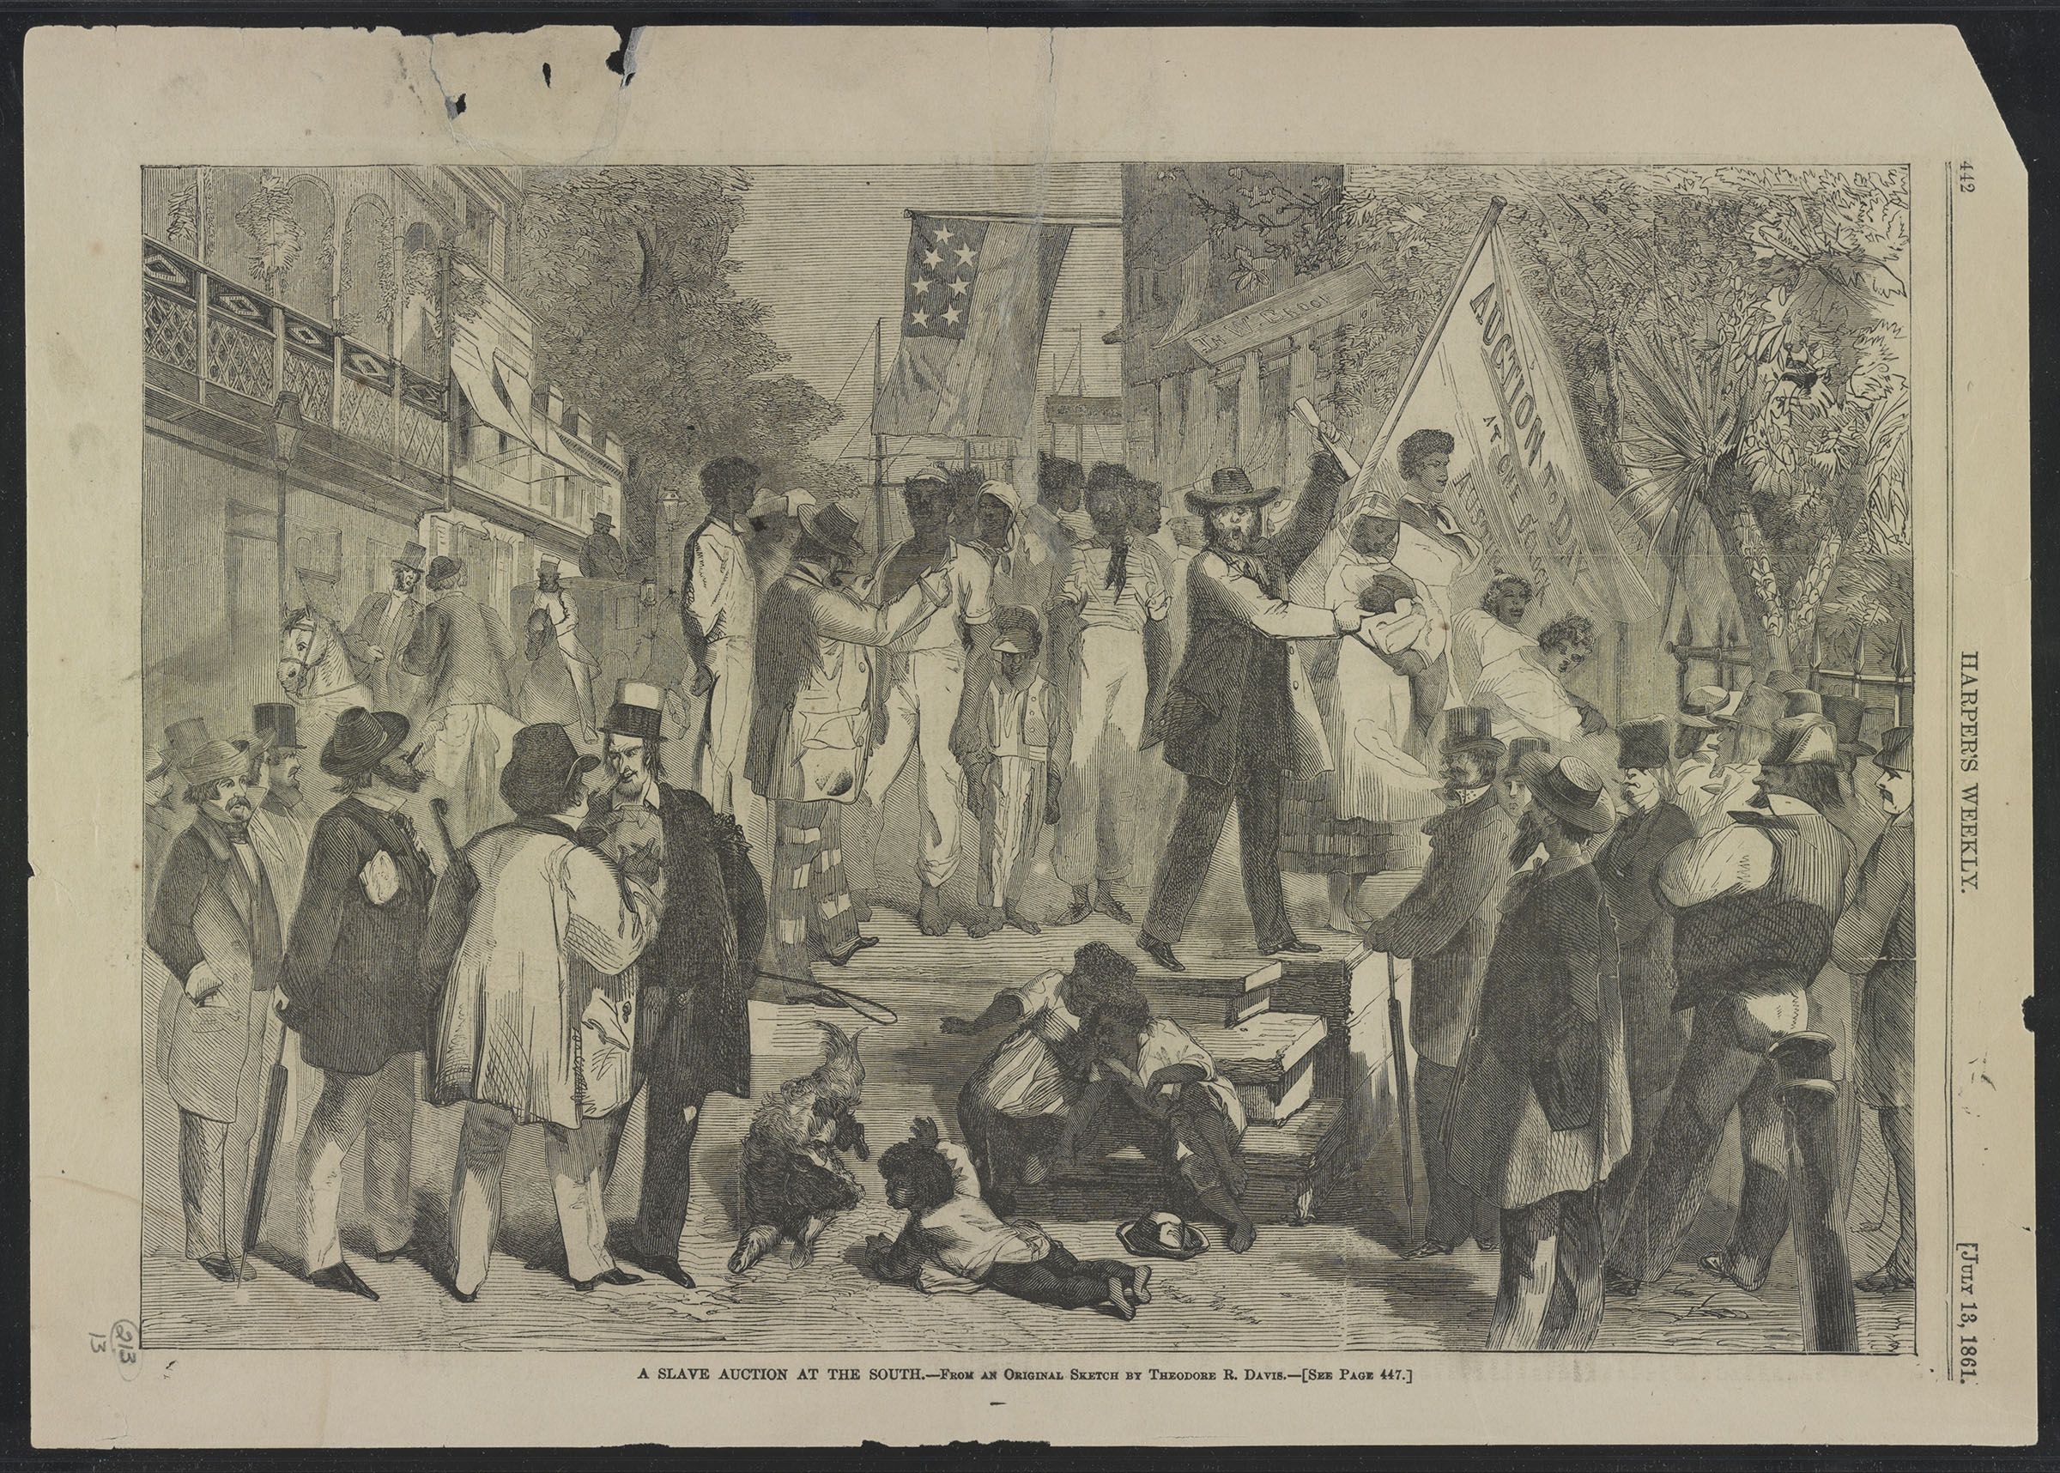
Notes:
An 1861 illustration depicting a slave auction in the south.

Slide 13
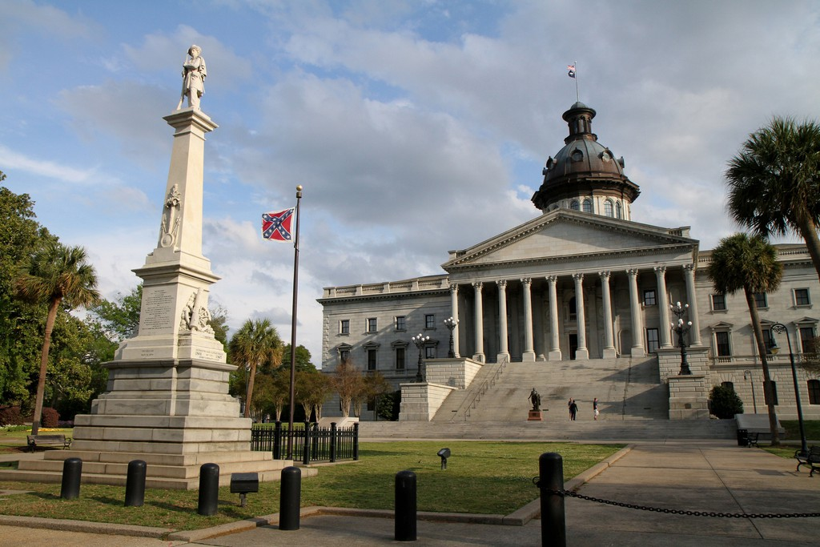
Notes:
The South Carolina State Capitol, featuring a large Confederate monument, and the Confederate flag. The flag was removed in 2015.

Slide 14
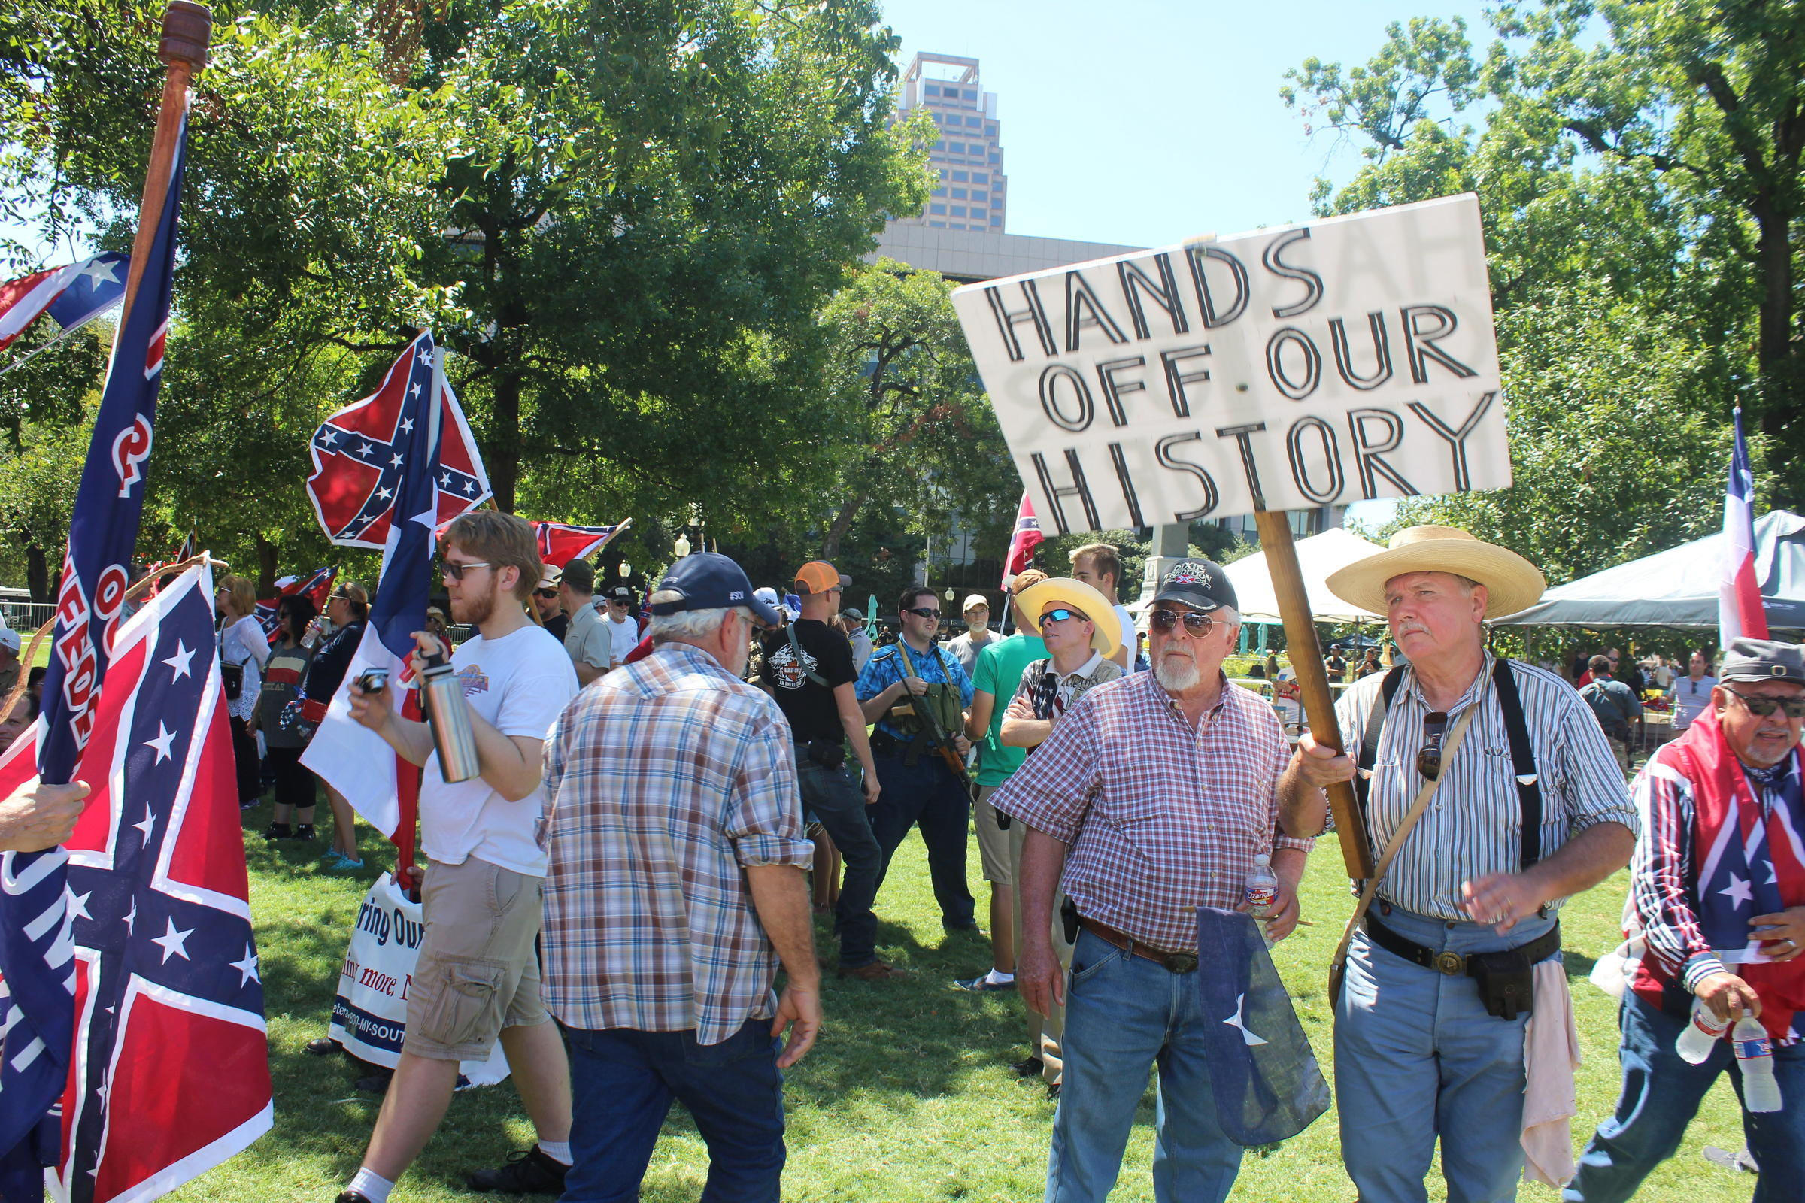
Notes:
The South Carolina State Capitol, featuring a large Confederate monument, and the Confederate flag. The flag was removed in 2015.

Slide 15
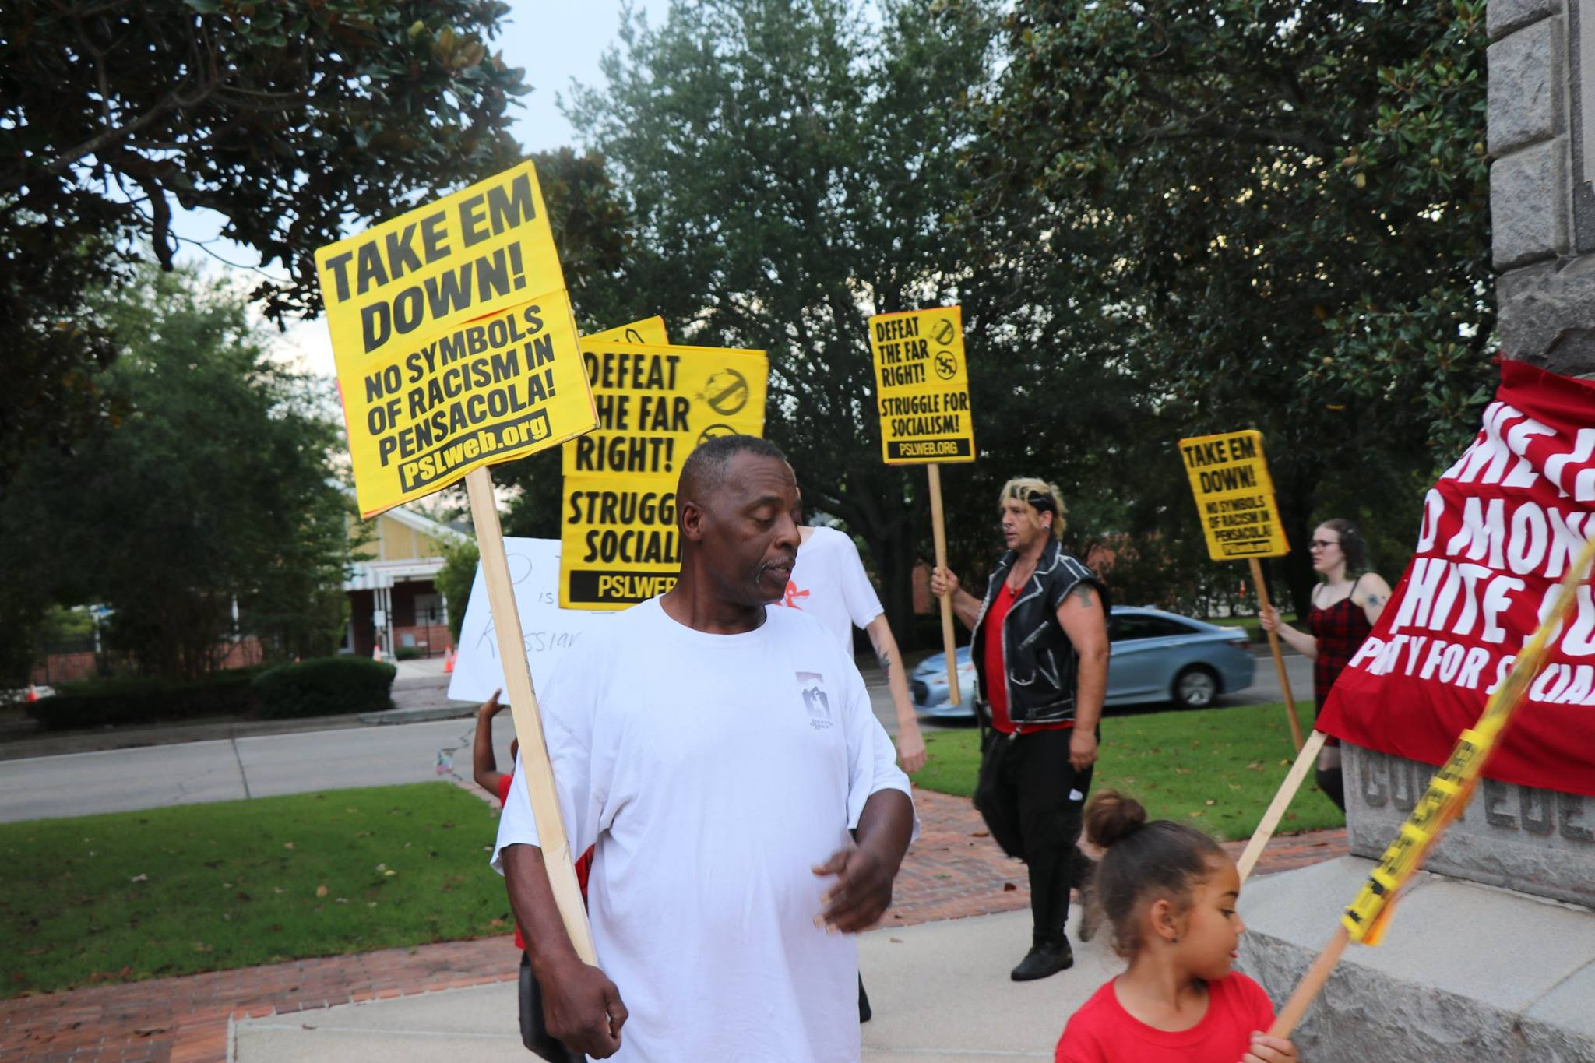
Notes:
The South Carolina State Capitol, featuring a large Confederate monument, and the Confederate flag. The flag was removed in 2015. Anti-Confederate protestors in Florida in 2018.

Slide 16
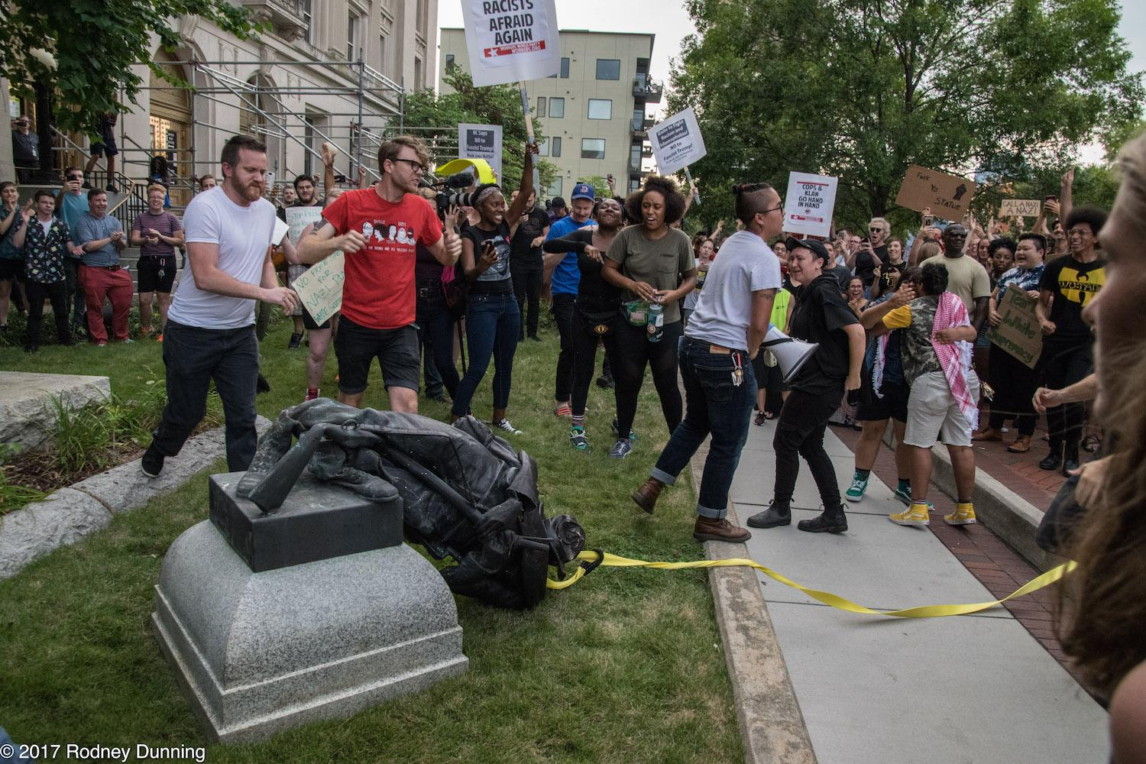
Notes:
Anti-Confederate protestors pulled down a Confederate statue in North Carolina in 2017.

Slide 17
Notes:
An 1861 illustration depicting a slave auction in the south.

Slide 18
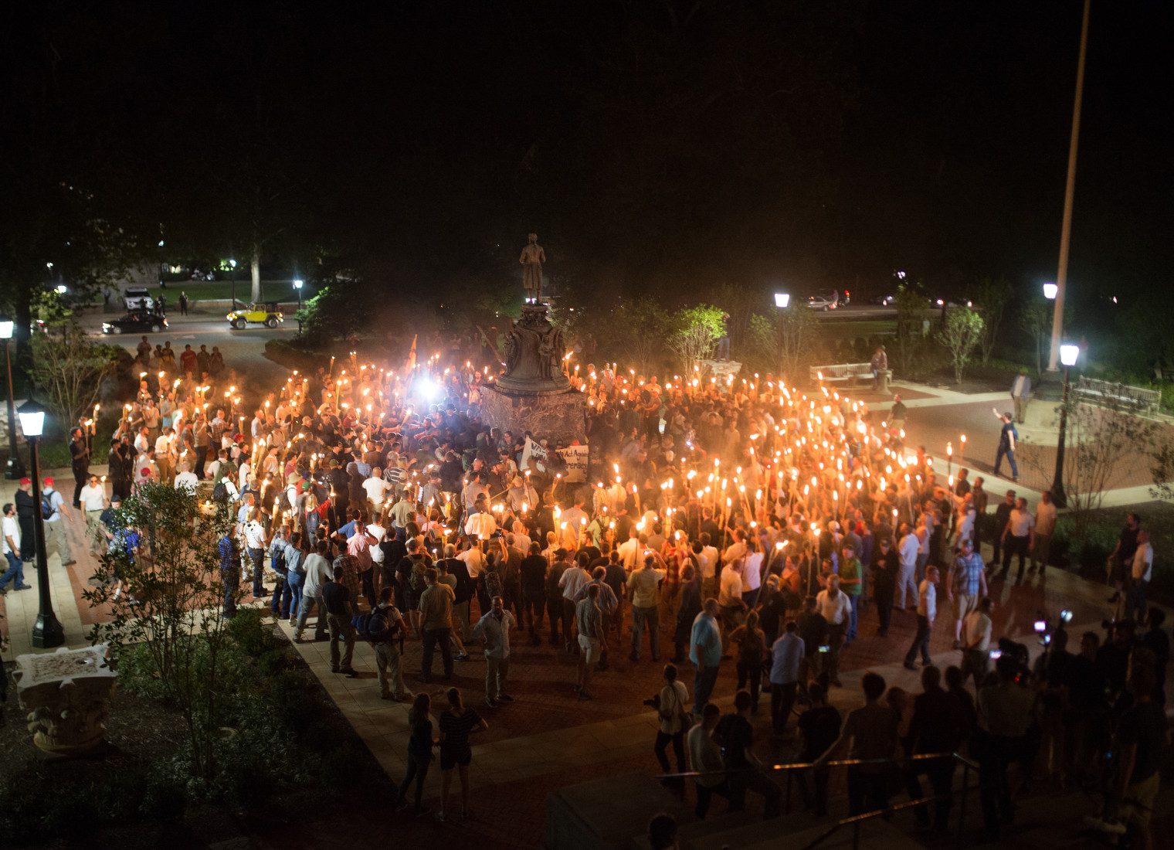
Notes:
Confederate monument supporters and white supremacists gather in Charlottesville, Virginia in 2017.

Slide 19
Photo 1: https://www.loc.gov/item/99447021/
Photo 2: https://www.warhistoryonline.com/american-civil-war/propaganda-civil-war.html
Photos 3-5, 8: https://timeline.com/civil-war-propaganda-highlighted-the-cause-of-slavery-when-the-government-wouldnt-200f154780dc
Photo 6: https://segregationinamerica.eji.org/report/confederate-icongraphy.html
Photo 7: https://en.wikipedia.org/wiki/Stonewall_Jackson
Photo 9: https://dustyoldthing.com/civil-war-soldiers-rations/
Photo 10: https://www.goodreads.com/book/show/1628534.How_the_North_Won
Photos 11: https://allthatsinteresting.com/civil-war-photos
Photo 12: https://www.pbs.org/video/history-detectives-wearing-the-confederate-uniform-slave-or-soldier/
Photo 13: https://www.onlyinyourstate.com/georgia/rare-photos-stone-mountain-monument-construction-ga/
Photo 14: https://www.history.com/news/harriet-tubman-combahee-ferry-raid-civil-war
Photo 15: https://www.washingtonpost.com/history/2019/10/12/it-was-nations-largest-auction-enslaved-people-now-search-descendants-weeping-time/
Photo 16: https://theculturetrip.com/north-america/usa/mississippi/articles/this-state-flag-is-the-last-to-feature-a-confederate-battle-flag-design/
Photo 17: https://en.wikipedia.org/wiki/The_Birth_of_a_Nation
Photo 18: https://www.tpr.org/post/conflicting-rallies-converge-travis-park-over-confederate-monument
Photo 19: https://www.liberationnews.org/take-em-pensacola-activists-protest-confederate-monument-lee-square/
Photo 20: https://wusfnews.wusf.usf.edu/post/after-protest-manatee-county-votes-remove-confederate-statue
Photo 21: https://www.facingsouth.org/2017/08/institute-index-intensifying-battle-over-removing-confederate-monuments
Photo 22: https://time.com/charlottesville-white-nationalist-rally-clashes/

